Slide 1
Data and Concept Drift

Slide 2
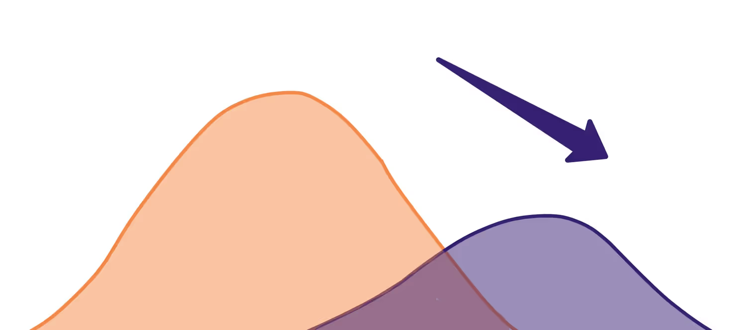
What can go wrong?
Machine learning models often deal with corrupted, late, or incomplete data. Data quality issues account for a major share of failures in production.
But let’s say it is covered. The data engineering team does a great job, data owners and producers do no harm, and no system breaks. Does this mean our model is safe?
Simple No. While the data can be right, the model itself can start degrading.

Slide 3
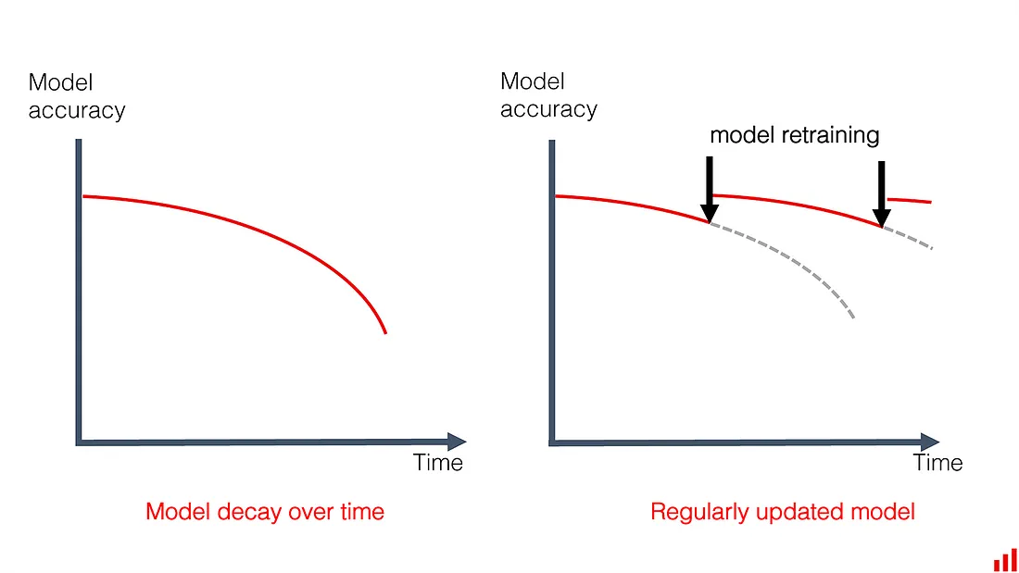
Model decay
Things change, and model performance degrades over time. The ultimate measure is the model quality metric. It can be accuracy, mean error rate, or some downstream business KPI, such as click-through rate.
No model lives forever, but the speed of decay varies.
Some models can last years without an update.
For example, certain computer vision or language models. Or any decision system in an isolated, stable environment.
Others might need daily retraining on the fresh data.

Slide 4
Why Model drifts?
When data quality is fine, there are two usual suspects:
data drift
concept drift
Or both at the same time.

Slide 5
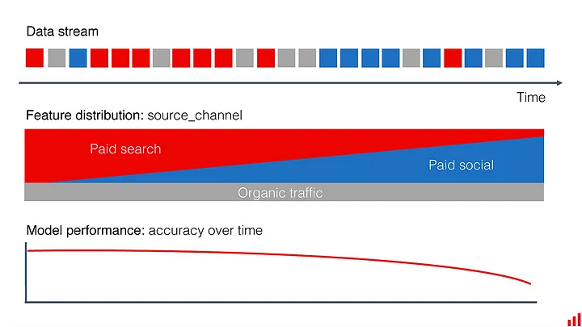
Data drift
Data drift, feature drift, population, or covariate shift, Which is: the input data has changed.
The distribution of the variables is meaningfully different. As a result, the trained model is not relevant for this new data.
It would still perform well on the data that is similar to the “old” one!
Example:
An online marketplace attracts users through advertising. Soon after newcomers sign up, we want to predict how likely they will make a purchase in order to send them personalized offers.
Previously most user acquisition happened through paid search. After a new ad campaign, a lot of users come from Facebook. In training, our machine learning model did not do well in this segment. It had limited examples to learn from.
Still, the overall model quality was sufficient since this sub-population was small. Now that it grew, the performance predictably dropped

Slide 6
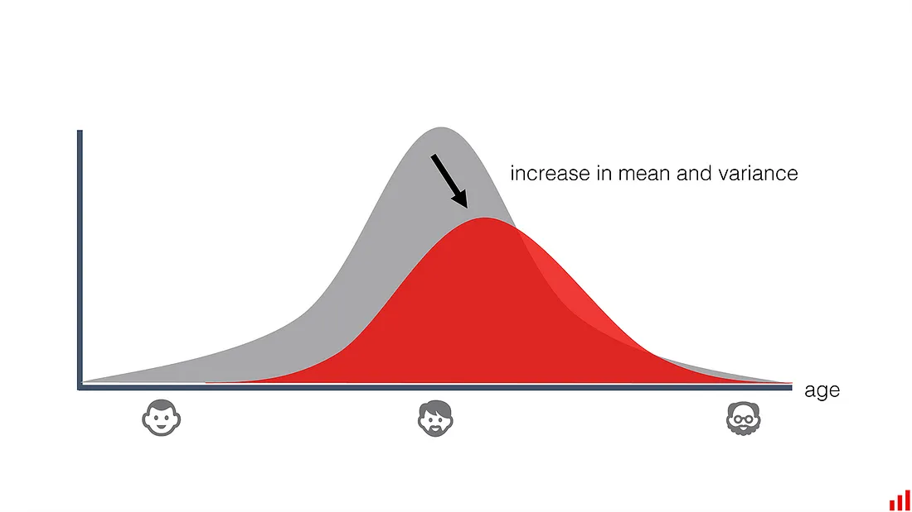
When debugging, we would see the change in class frequencies in the “source_channel” and distributions of other related variables, such as “device,” “region,” and so on.
Or, with the monitoring in place, we’d notice this drift early on!
Similar things happen when applying a model in a new geographical area. Or, if the growing audience starts to include a new demographic segment, and so on.
In these examples, the real-world patterns can remain the same. But the model performance drops as its quality varies for different data regions. The decay can range from minor to dramatic — when the drift affects the most important features.
To address it, we need to train the model on the new data or rebuild it for the new segment.

Slide 7
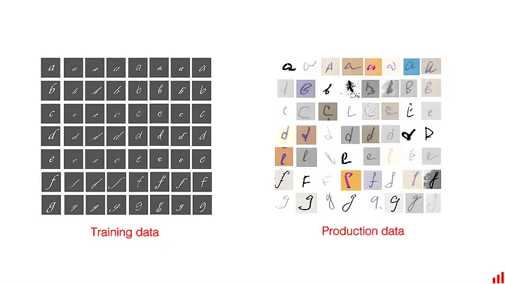
Training-serving skew
It is often mixed with data drift or used interchangeably. The way we analyze them might indeed be similar, but the root cause of skew is not the same.
In this case, there is no “drift,” which assumes a change during the production use of the model. Training-serving skew is more of a mismatch. It reveals at the first attempt to apply the model to the real data.
It often happens when you train a model on an artificially constructed or cleaned dataset. This data does not necessarily represent the real world, or does this incompletely.
For example, an invoice classification model is trained on a limited set of crowdsourced images. It does well on the test set. But once put in production, it is surprised by the diversity of how people fill in the invoice data. Or the low quality of scanned images compared to model training.

Slide 8
Concept drift
Concept drift occurs when the patterns the model learned no longer hold.
In contrast to the data drift, the distributions (such as user demographics, frequency of words, etc.) might even remain the same. Instead, the relationships between the model inputs and outputs change.
In essence, the very meaning of what we are trying to predict evolves. Depending on the scale, this will make the model less accurate or even obsolete.
Concept drift comes in different flavors.
Gradual
Sudden

Slide 9
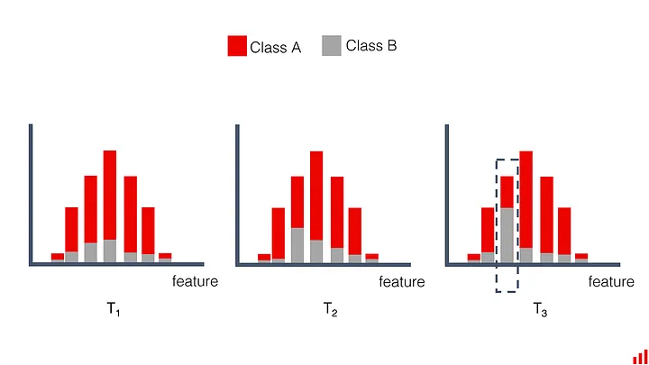
Gradual concept drift
The world changes and the model grows old. Its quality decline follows the gradual changes in external factors.
Some examples:
Competitors launch new products. Consumers have more choices, and their behavior changes. As should sales forecasting models.
Macroeconomic conditions evolve. As some borrowers default on their loans, the credit risk is redefined. Scoring models need to learn it.
Mechanical wear of equipment. Under the same process parameters, the patterns are now slightly different. It affects quality prediction models in manufacturing.
No individual change is dramatic. Each might affect only a tiny segment. But eventually, they add up. Sometimes it is possible to observe the shift at a level of individual features.

Slide 10
How fast do models age?
It depends, of course. But it is often possible to get an estimate ahead of time.
EX: If we are building a supervised prediction model, we know the past ground truth. We can train the model on older data and apply it to later periods. Then we can imitate model retraining with different frequencies and measure how it impacts model quality.
Such a test gives us a good proxy on regular model retraining needs. Does each new week’s data improve the performance? Or a 3-month old model still performs as good as new?

Slide 11
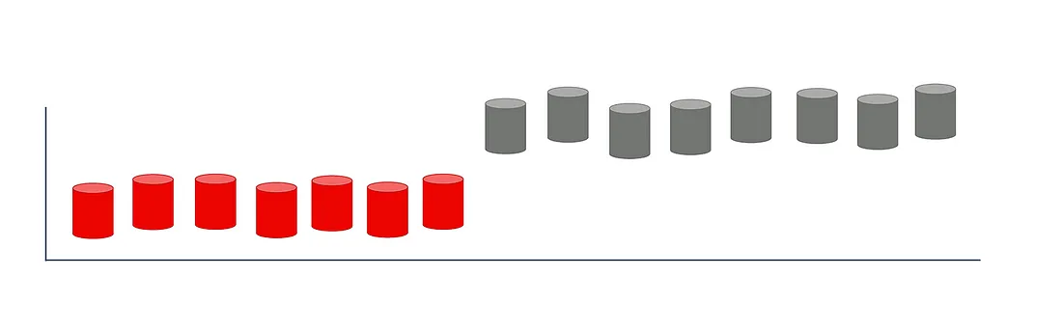
Sudden concept drift

Slide 12
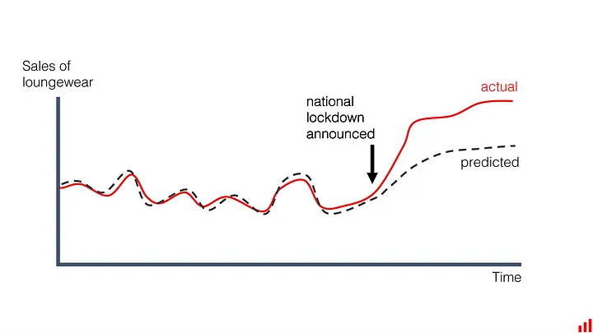
External changes might be more sudden or drastic. These are hard to miss. As we shared in our recent post, the COVID-19 pandemic is a perfect example. Almost overnight, the mobility and shopping patterns shifted. It affected all sorts of models, even otherwise “stable” ones.
Demand forecasting models would not guess that sales of yoga pants surge 350% (like it happened to Stitch Fix) or that most flights will be canceled as borders close.
Were you working to recognize pneumonia on X-ray images? You instantly got a new label.
In a more ordinary course of events, you can experience things like:
Change in the interest rate by the central bank. All financial and investment behavior is affected, and models fail to adapt to unseen patterns.
Technical revamp of the production line. Predictive maintenance becomes obsolete since modified equipment has new failure modes (or lack of those).
Major update in the app interface. Past data on clicks and conversion becomes irrelevant since the user journey is a new one.

Slide 13
Dealing with drift
In the case of radical shifts, models break. You might want to pause it until more data is collected. As a fallback strategy, you can use expert rules or heuristics.
To get back on track, we need to retrain the model. Approaches vary:
Retrain the model using all available data, both before and after the change.
Use everything, but assign higher weights to the new data so that model gives priority to the recent patterns.
If enough new data is collected, we can simply drop the past.
“Naive” retraining is not always enough. If the problem has evolved, we might need to tune the model, not feed the latest data into the existing one.
Options include domain adaptation strategies, building a composition of models that use both old and new data, adding new data sources, or trying entirely new architectures.
Sometimes it’s best to modify the model scope or the business process. It can be shortening the prediction horizon or running the model more frequently. For example, retailers facing shifts in shopping habits might switch from weekly to daily demand forecast.
Communication matters, too. Like with interface updates, changes can come from inside the business. Here, you need to align business owners and model maintainers. An early warning will help you prepare the model for a new cold start.

Slide 14
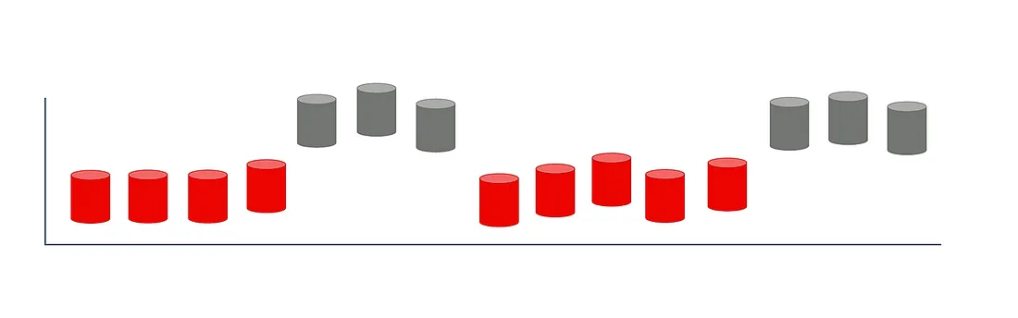
Recurring concept drift

Slide 15
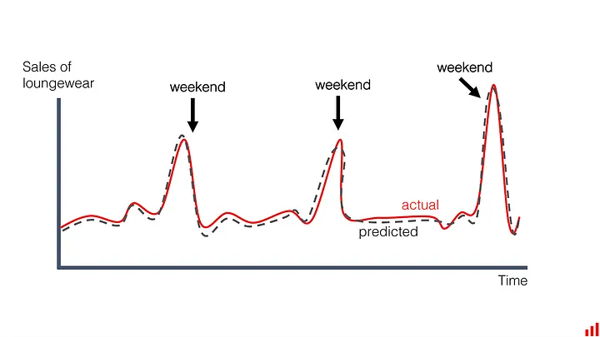
Seasonality is a known modeling concept. It indeed looks like (and it is) a temporary change in the target function.
The same people that shop modestly during the year show unusual patterns on Black Fridays. Bank holidays affect everything, from retail sales to production failures. Mobility on the weekend is different from business days. And so on.
From the point of model monitoring, this “drift” has no importance. Weekends happen every week, and we don’t need an alert. Unless we see a new pattern, of course.
How to treat this not-exactly-drift in production?
Teach your model the seasonality.
If it first sees some special events or seasons in production, you can use other similar events as examples. For instance, if a new bank holiday is introduced, you can assume a similarity with a known one.

